Slide 1
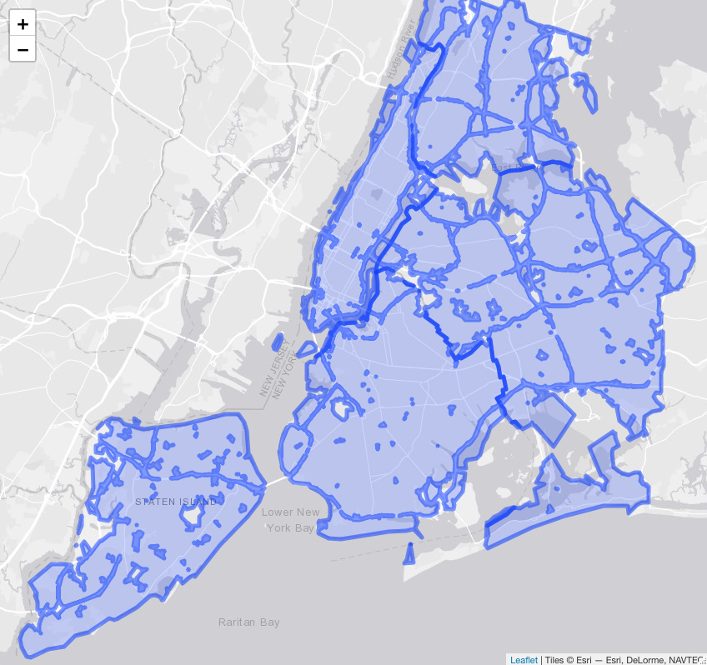
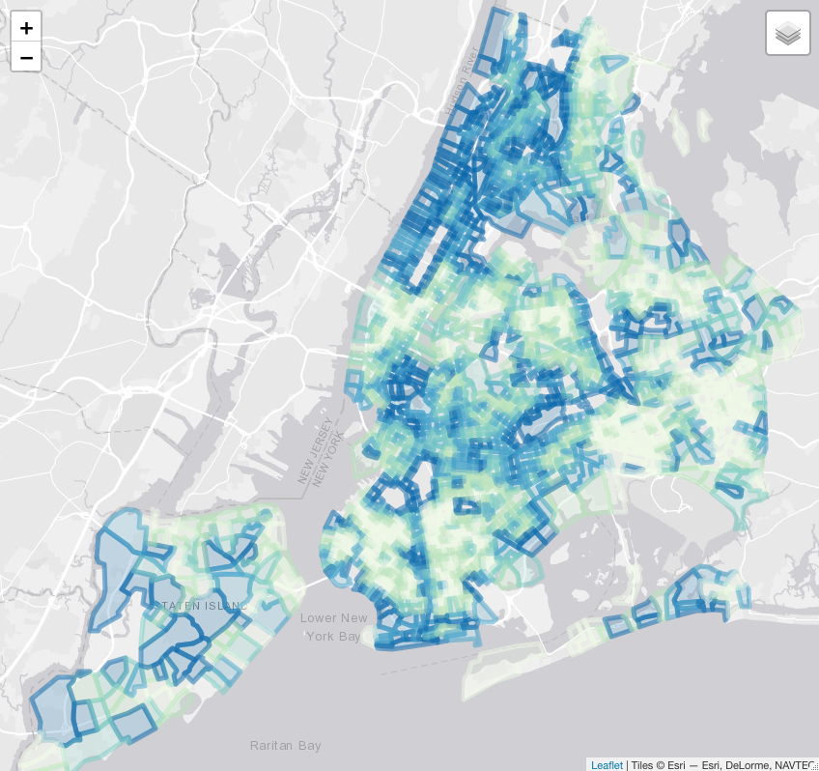
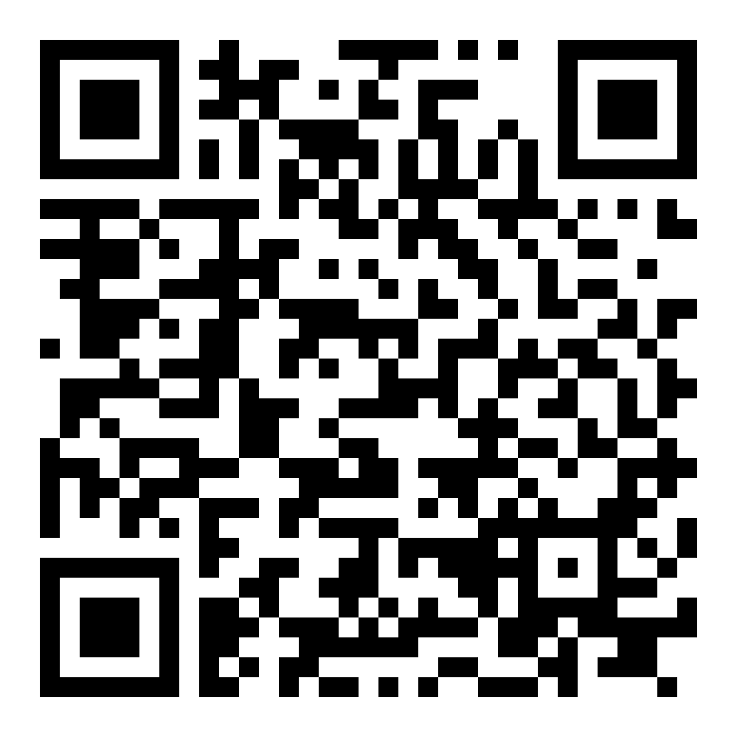

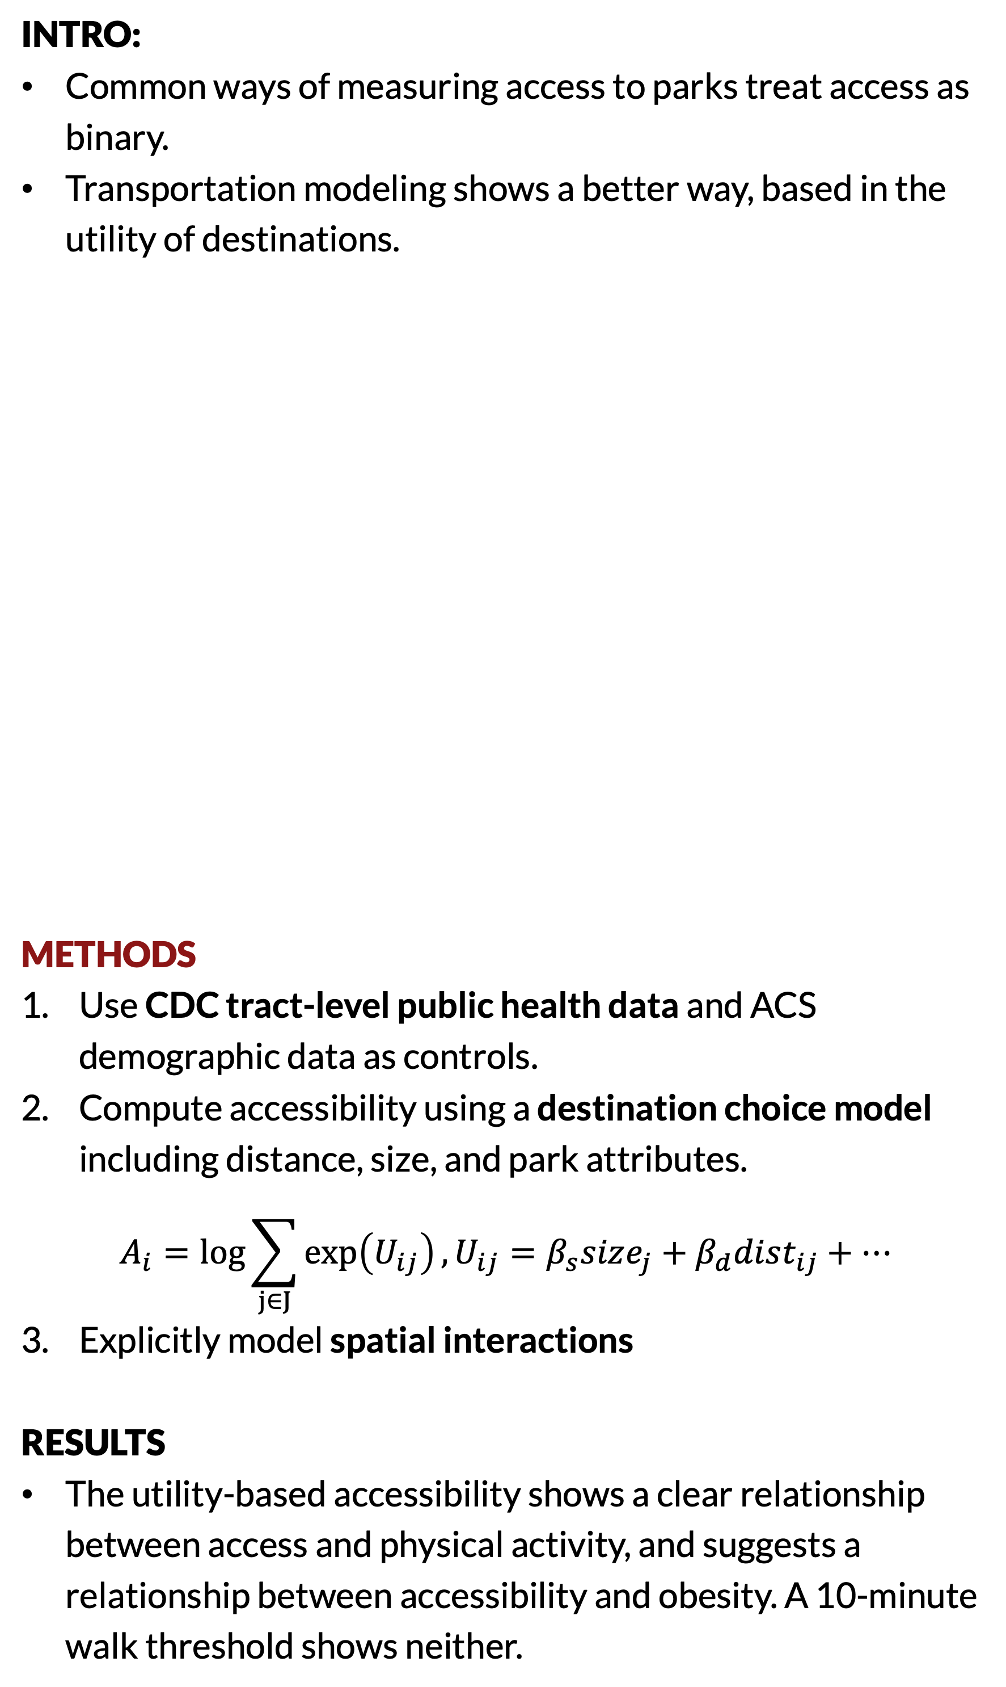
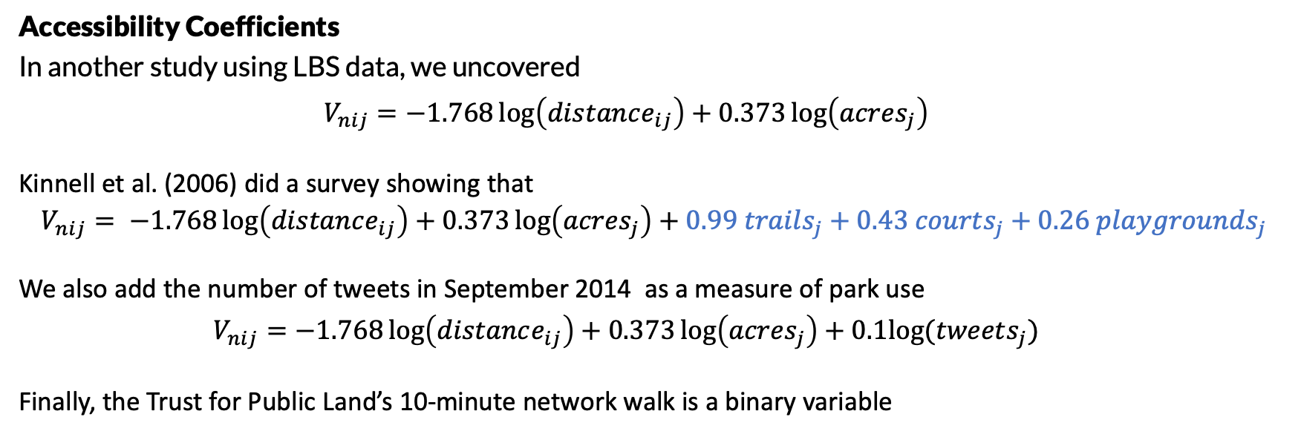
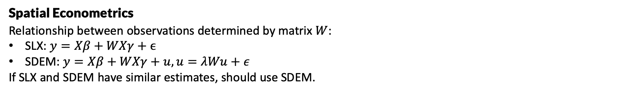
Utility-based accessibilities show how access to parks affects public heath.
Non-Cognitive Predictors of Student Success: A Predictive Validity Comparison Between Domestic and International Students
Non-Cognitive Predictors of Student Success: A Predictive Validity Comparison Between Domestic and International Students
Modeling the impacts of park access on health outcomes:
A utility-based accessibility approach
Accessibility Coefficients
In another study using LBS data, we uncovered
$$V_{nij}=−1.768\log\left(distance_{ij}\right)+0.373\log\left(acres_{j}\right)$$
Kinnell et al. (2006) did a survey showing that
$$V_{nij}= −1.768\log\left(distance_{ij}\right)+0.373\log\left(acres_{j}\right)+0.99 trails_{j}+0.43 courts_{j}+0.26 playgrounds_{j}$$
We also add the number of tweets in September 2014 as a measure of park use
$$V_{nij}=−1.768\log\left(distance_{ij}\right)+0.373\log\left(acres_{j}\right)+0.1log⁡(tweets_{j})$$
Finally, the Trust for Public Land’s 10-minute network walk is a binary variable
PRESENTER: Greg Macfarlane
INTRO:
Common ways of measuring access to parks treat access as binary.
Transportation modeling shows a better way, based in the utility of destinations.
METHODS
Use CDC tract-level public health data and ACS demographic data as controls.
Compute accessibility using a destination choice model including distance, size, and park attributes.
$$A_{i}=\log{\sum_{j∈J}{\exp\left(U_{ij}\right)}}, U_{ij}=β_{s}size_{j}+β_{d}dist_{ij}+…$$
Explicitly model spatial interactions
RESULTS
The utility-based accessibility shows a clear relationship between access and physical activity, and suggests a relationship between accessibility and obesity. A 10-minute walk threshold shows neither.
Spatial Econometrics
Relationship between observations determined by matrix $W$:
SLX: $y=Xβ+WXγ+ϵ$
SDEM: $y=Xβ+WXγ+u, u=λWu+ε$
If SLX and SDEM have similar estimates, should use SDEM.
Effects of Access on Physical Activity
Effects of Access on Obesity
Gregory Macfarlane, Nico Boyd, John Taylor, Kari Watkins
Notes:
Notes:
In Powerpoint, click View > Guides
Keep text within gutter guides.
Author list: Don’t split names onto two lines (e.g., “Jimmy [break] Smith”). If that happens, use a new line, unless you need the space. Bold the first names of anybody who’s presenting in person.
Intro/methods/result: Do not drop below font size 28, but if you have extra space, jack up the font size until the space is full.
Do not use color in the sidebars except in graphs/figures. It’ll pull attention from the center and slow interpretation for passersby.

